Slide 1
Kognitive Project Update
Milipol TechX 2026 — Cognitive Robotics Demo
Week of February 10, 2026
Sprint 1: COMPLETE — Sprint 2: IN PROGRESS

Slide 2
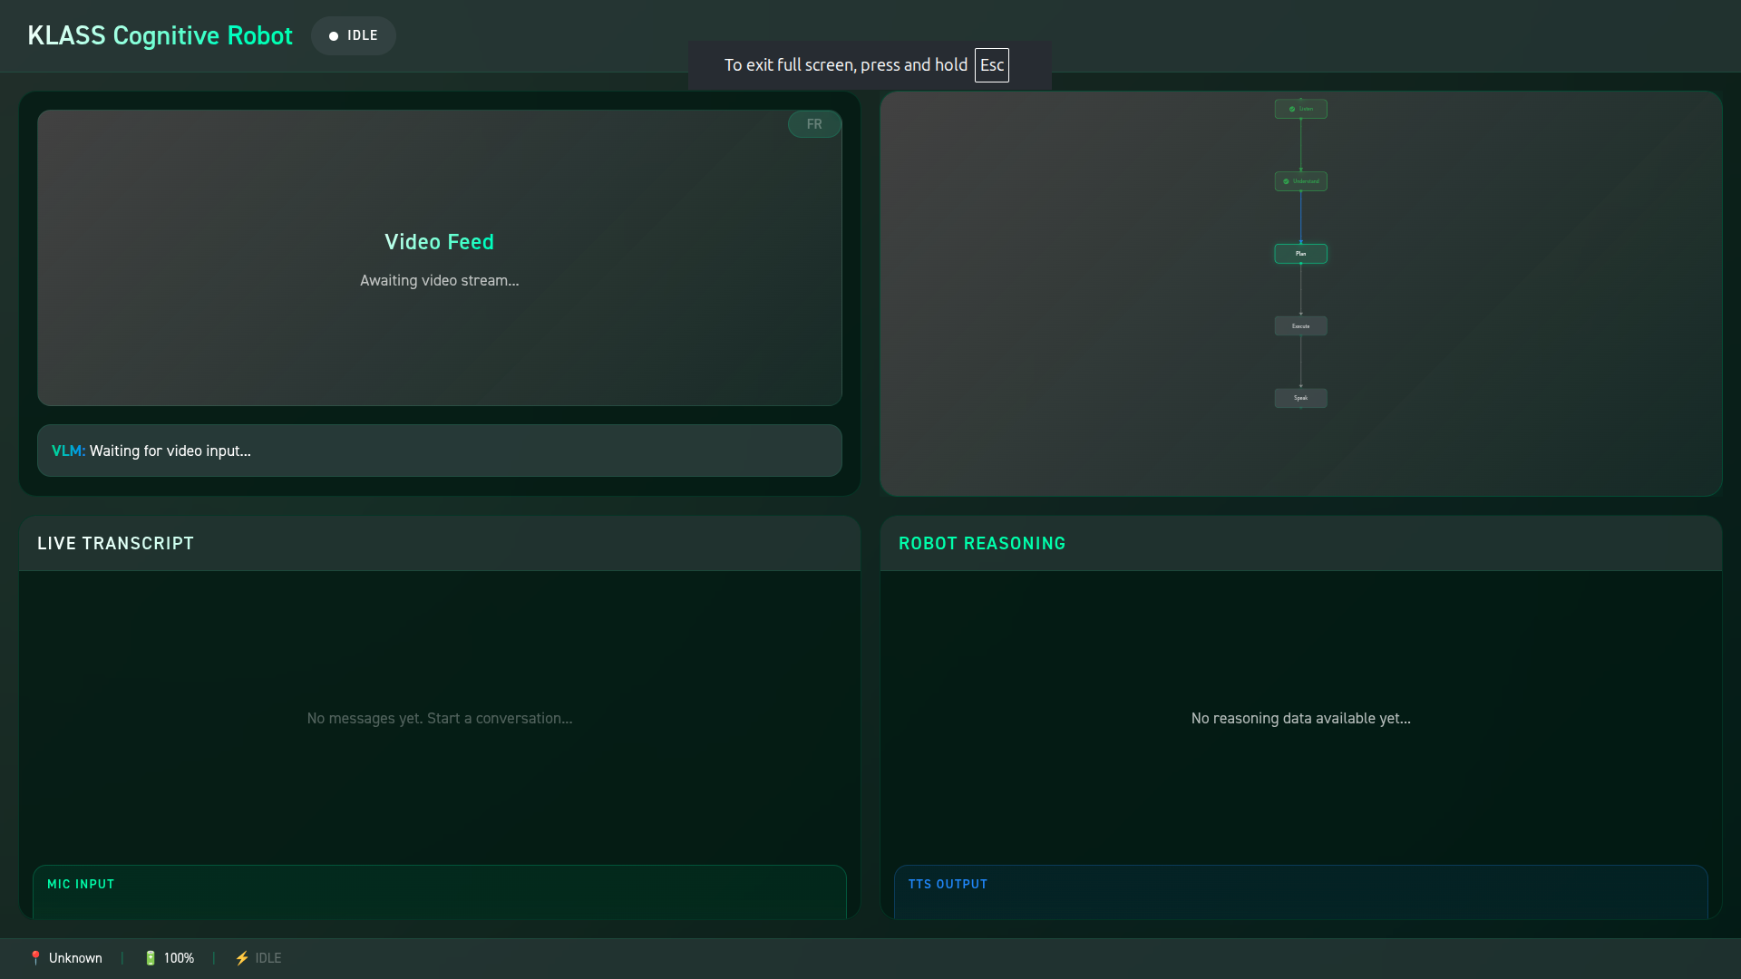
Dashboard UI
Camera Stream Dashboard
Multi-camera monitoring system with live streaming
Real-time metrics: bandwidth, latency, FPS
Recording controls per camera feed
3 active cameras: Front Left, GoPro, Front Right
Dashboard screenshot to be added

Slide 3
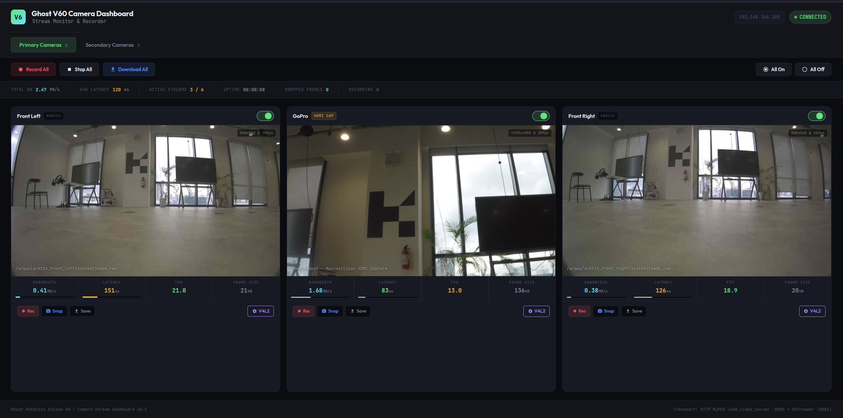
Face Recognition Data Collection
Video Data Collection System
Multi-camera video streaming for training data
Face detection and recognition pipeline
Real-time performance monitoring
Data export and logging capabilities
FR screenshot to be added

Slide 4
Sprint 2 Priorities
Feb 13 - Feb 26: Speech Loop Works
TARGET E2E LATENCY
End-to-end conversation flow
State machine implementation
DAG planning with LLM integration
KlassUI Dashboard scaffold
WebSocket connections to all services
Basic scenario testing
< 5 seconds
STT ACCURACY
> 90%
SCENARIOS
1 & 2 Working

